Slide 1
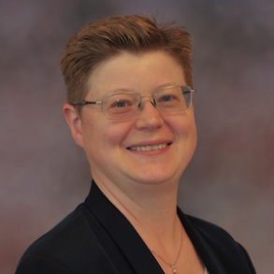
Hands-on workshop QIIME
Thursday June 21st 2018, 9:00 am - 4:00 pm.
Domus medica, Gaustad, Oslo University
Amanda Birmingham, Center for Computational Biology and Bioinformatics in the University of California, San Diego is visiting Norway and will lead a one-day QIIME workshop.
The course will provide a theoretical, analytical and practical introduction to QIIME which stands for Quantitative Insights into Microbial Ecology. QIIME are an open source software package for comparison and analysis of microbial communities, primarily based on high-throughput amplicon sequencing data (such as SSU rRNA) generated on a variety of platforms, but also supporting analysis of other types of data (such as shotgun metagenomics, metabolomics or proteomics).
Registration at this link: https://skjema.uio.no/98134
Registration deadline: June 10th 2018. Space is limited for this course, please register now!
Location: Room L-257, Domus Medica (DM4), Gaustad, Oslo University
Course fee: Free of charge (sponsored by TTA)
Participants will receive reading list and further instructions upon accepted registration/payment.
Some experience in metagenomics is required, please describe your experience as requested in the registration. You will need to bring your laptop to the workshop, as a significant portion of the workshop will be hands-on. Any operating system will work, including Windows, Mac OS X, and Linux. You will receive information regarding software you need to install. There will be power outlets and WiFi available to you at the workshop.
Instructor:
Amanda Birmingham’s wide-ranging experience in bioinformatics for genomics and metagenomics spans both industry and academia. As a Senior Bioinformatics Engineer at the Center for Computational Biology and Bioinformatics at the University of California, San Diego, she devises novel computational pipelines to extract insights from next-generation sequencing data. Her focus is on developing open-source software enabling microbiome research, and on training biologists and data scientists world-wide. Her earlier career was as spent as head of bioinformatics at Dharmacon, Inc., where she led a team in data analysis, reagent design, and software development.
Questions: Jørgen Vildershøj Bjørnholt, email: joerbj@ous-hf.no
HUMIS/NoMIOC cohort

